Slide 1
Weather Data Analysis: Cairo, Egypt
Time-Series Exploratory Data Analysis (2022-2023)
Task 4 Presentation

Slide 2
Objectives & Data Source
Project Goal:
Perform robust time-series EDA on weather data.
Data Source:
NASA POWER API (free, reliable, daily temporal resolution).
Parameters Collected:
Temperature (Mean, Min, Max), Precipitation, Humidity, Wind Speed, Cloud Cover.
Location & Timeframe:
Cairo, Egypt (Lat: 30.0444, Lon: 31.2357).
January 1, 2022 to December 31, 2023 (730 days).

Slide 3
Data Preparation & Cleaning
Parsing & Indexing:
Dates parsed and set as the DataFrame index (Daily frequency).
Handling Sentinels:
NASA's missing value code (-999.0) replaced with NaN.
Missing Value Imputation:
Linear Interpolation (limit = 3 days).
Justified: weather changes smoothly day to day.
Validation:
No missing dates in the 730-day sequence.
Units verified (Temperature in C, Rainfall in mm, etc.).

Slide 4
Descriptive Statistics
Temperature (C):
Mean ~22.5 C | Range: ~10 C (Winter) to ~35 C+ (Summer).
Precipitation (mm/day):
Extremely right-skewed: most days have 0 mm rainfall (arid city).
Humidity:
Inversely related to temperature: drier in summer, more humid in winter.
Wind Speed:
Stable year-round with no strong seasonal pattern.

Slide 5
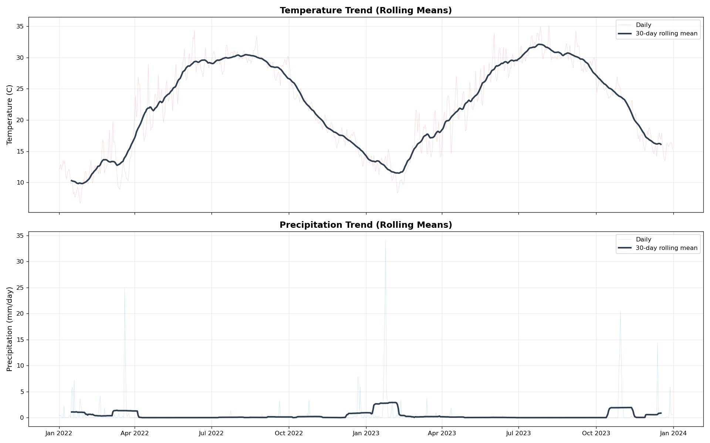
Temporal Trends
Daily values overlaid with 7-day and 30-day rolling means for temperature and precipitation.

Slide 6
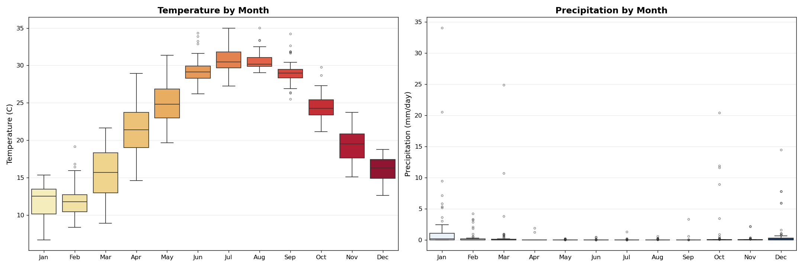
Seasonality Patterns
Monthly boxplots showing temperature peak in Jul/Aug and precipitation confined to Nov-Mar.

Slide 7
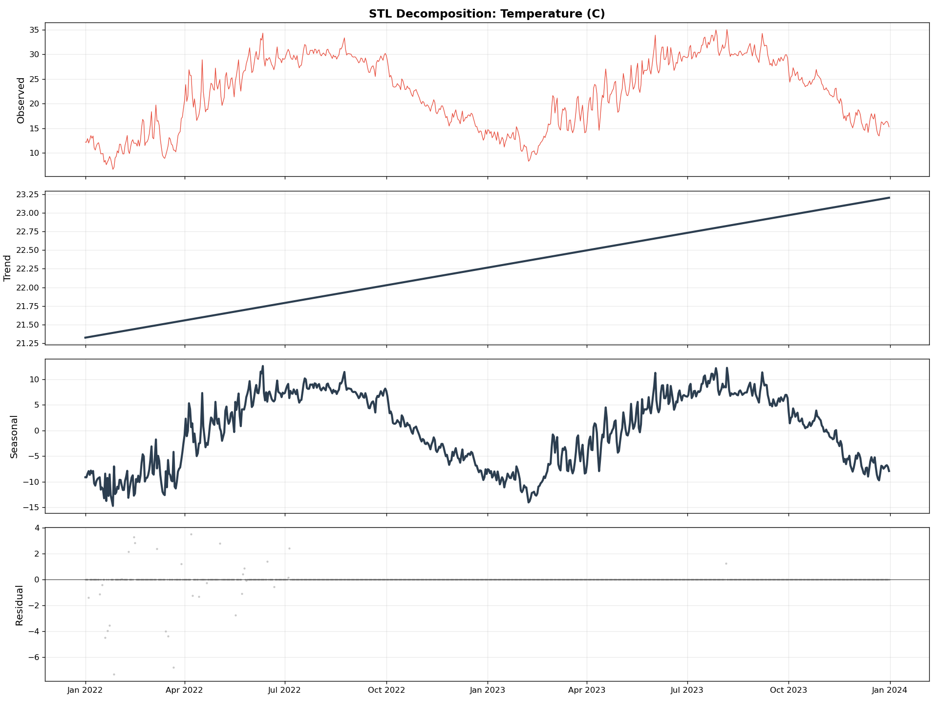
Time-Series Decomposition (STL)
Temperature decomposed into Trend, Seasonal, and Residual components using STL (Loess).

Slide 8
Autocorrelation & Stationarity
ACF & PACF:
Temperature ACF: Slow decay -- strong seasonality and memory.
Precipitation ACF: Drops immediately -- random and event-driven.
Augmented Dickey-Fuller Test:
Temperature: Non-stationary (strong seasonal cycle). Needs differencing for ARIMA.
Precipitation: Closer to stationary (mean hovers near zero).
Implication:
Temperature needs SARIMA / seasonal differencing for modeling.

Slide 9
Relationships & Anomalies
Correlation Matrix:
Temperature & Humidity: Negatively correlated (hot days = dry).
Precipitation & Cloud Cover: Positively correlated.
Outlier Detection (Rolling Z-Score, window=30, threshold=3 std):
Seasonal-aware: avoids flagging normal summer highs as outliers.
Suspicious Values Check:
No negative rainfall, no temperatures outside physical bounds,
No temp_min > temp_max. Data quality confirmed as excellent.

Slide 10
Conclusion
Key Findings:
Cairo's weather follows a strong, predictable annual seasonal cycle.
Precipitation is sparse and event-driven (arid desert climate).
Data quality from NASA POWER was excellent with no anomalies.
Modeling Implications:
Temperature: Use seasonal models (SARIMA, Prophet).
Precipitation: Use zero-inflated or count-based models.
Next Steps:
Ready for predictive modeling or feature engineering.

